Slide 1






SQL Project on pizza sales

Slide 2




Introduction
This SQL project is done to highlight insights on the pizza sales data
Let's start our adventure in the world of pizza!

Slide 3
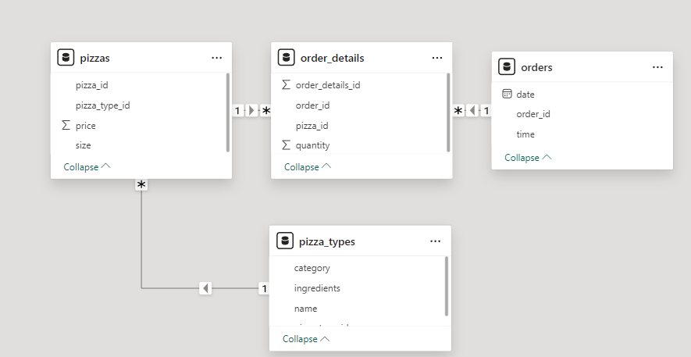

This SQL project is done to highlight insights on the pizza sales data

Slide 4


Slide 5
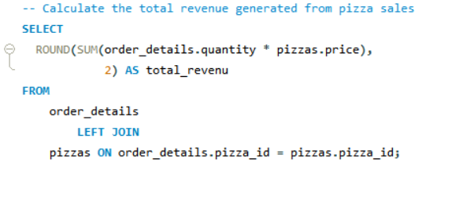

Slide 6
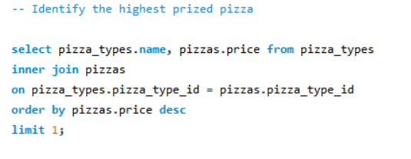

Slide 7
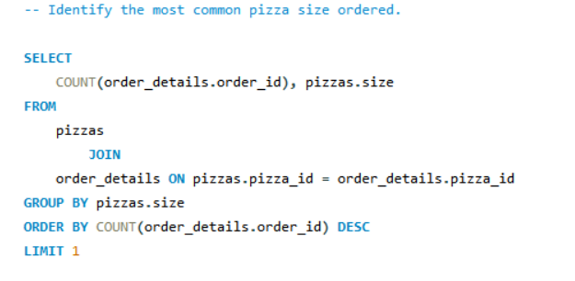
02

Slide 8
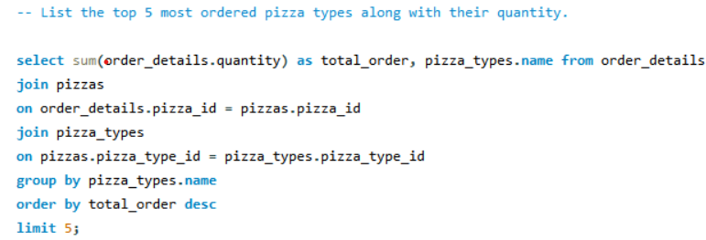

Slide 9
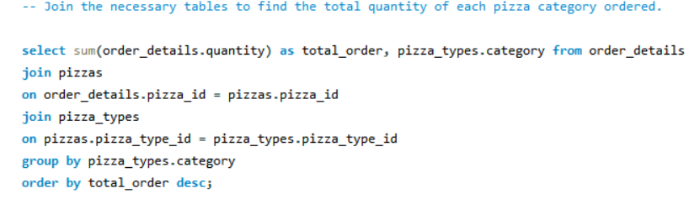

Slide 10
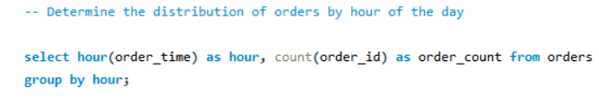

Slide 11
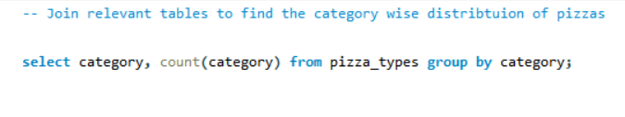

Slide 12
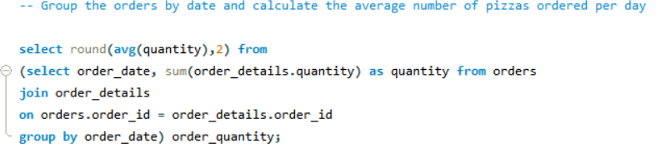

Slide 13
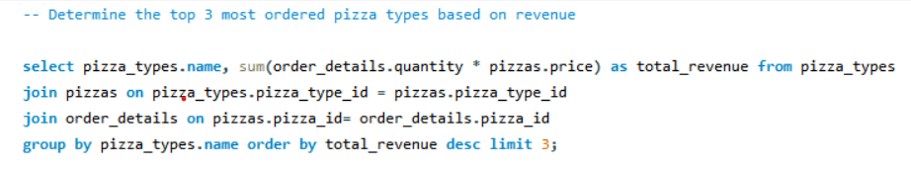

Slide 14
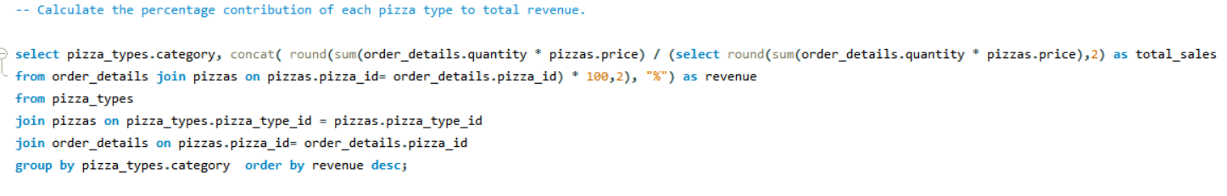

Slide 15
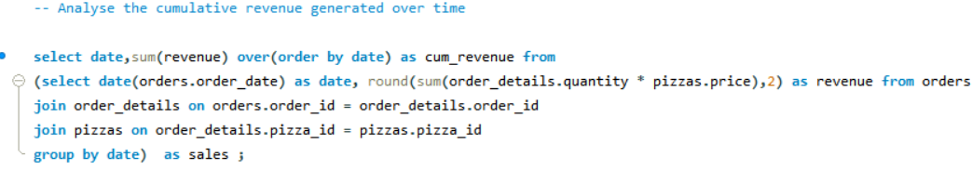

Slide 16
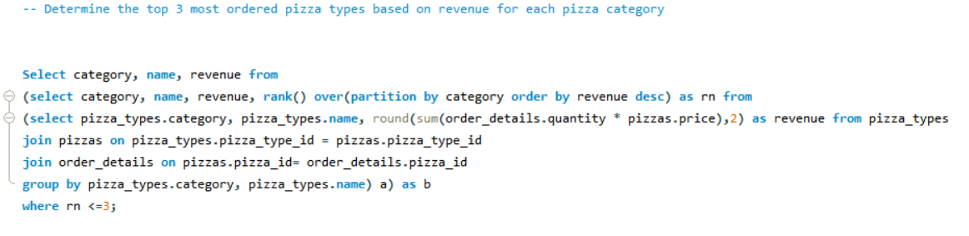

Slide 17

Thank You
“Have fun making your own pizza and enjoy every bite”

